Slide 1
Twin Oaks Hospice Agency Comparison
Prepared for Dr. Mark Smith, M.D.
August 1, 2020

Slide 2
OUR MISSION STATEMENT
To provide excellent quality hospice services that:
PATIENTS recommend to family and friends
PHYSICIANS prefer for their patients.
SUMMARY ON TWIN OAKS HOSPICE
Curabitur sem ante, blandit eu vehicula nec, dictum non mauris. Nulla volutpat tincidunt enim ac faucibus. Nullam et vehicula neque. Nulla rutrum est nisi, in mollis tortor porttitor semper. Ut varius et magna ullamcorper ullamcorper.
ABOUT TWIN OAKS HOSPICE
Based out of Savannah, Georgia
2,500 employees
500 physicians
650 hospice specialty staff
15,700 patients and growing

Slide 3
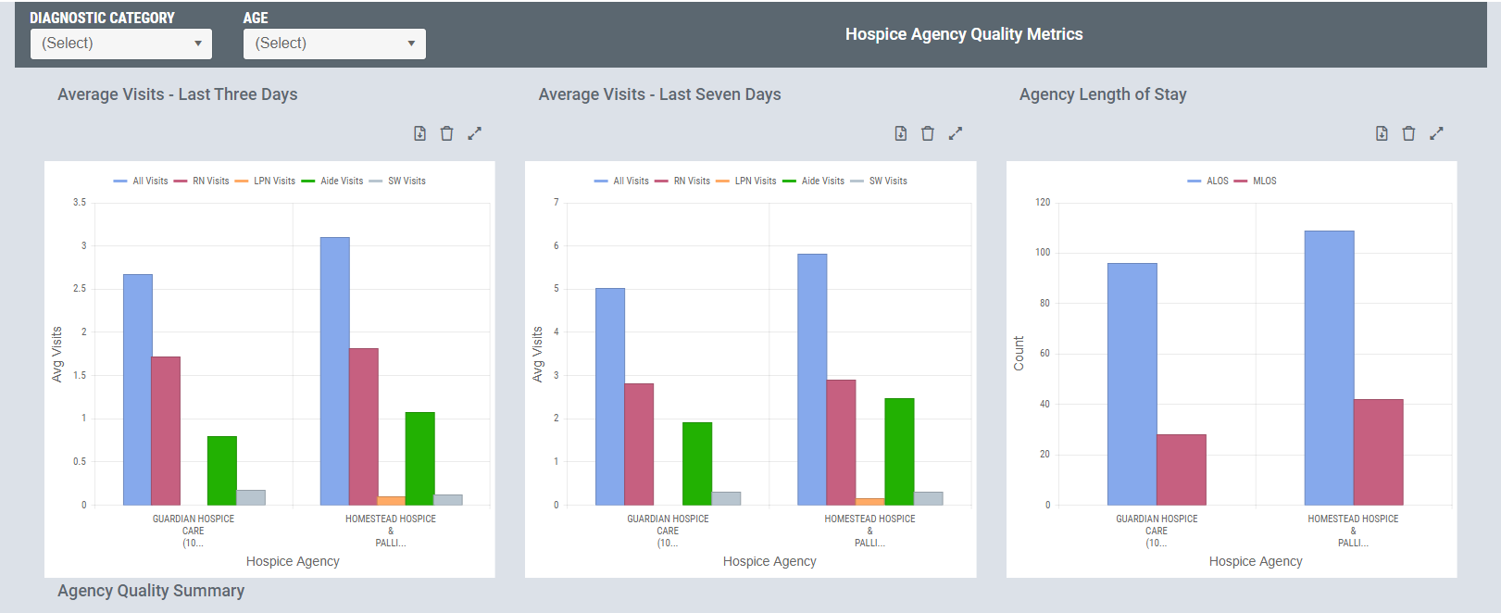
DR. MARK SMITH | TWIN OAKS HOSPICE
We are dedicated to providing comfort and relief to the seriously ill. That’s why we outperform our peers when it comes to {metric}. Our track record would make us a great partner for your facility.
Average visits – Last Three Days – Within the last three days of a patient’s life, their medical and therapeutic needs can change from moment to moment. We plan for these changes, communicate with the patient and their family, and tailor visits to ensure patients receive the best care possible.
Average visits – Last Seven Days – Our patient care plans account for every phase of a patient’s end-of-life care. In the last seven days, when a patient is actively dying, we increase total visits and implement a larger ratio of RN visits to keep pace with the patient’s changing care requirements.
Average Length of Stay (ALOS) – We focus on early hospice care and longer ALOS to help improve quality of care while potentially decreasing end-of-life costs for patients and their families.
Average visits – Last Three Days/Last Seven Days – The last three to seven days of a patient's life is that period where the patient is actively dying, and the type and frequency of care should change to reflect the different patient and family requirements. Although there is no numeric standard, CMS considers that excellent service in this period would include an increase of total visits and a larger ratio of visits by RNs to keep pace with changes in care requirements.
Average Length of Stay– Average length of stay for all patients discharged from this hospice within the specified time period.

Slide 4
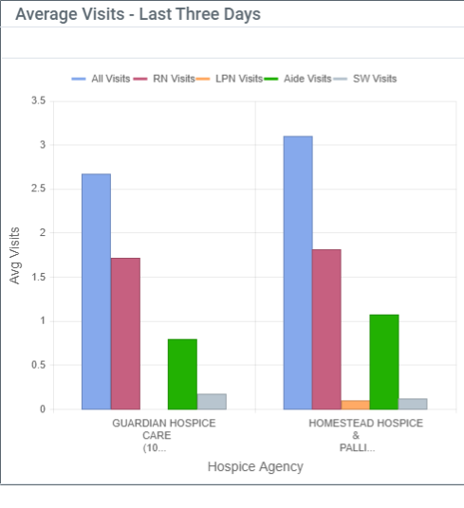
DR. MARK SMITH | TWIN OAKS HOSPICE
KEY METRIC: AVERAGE VISITS – LAST THREE DAYS
Within the last three days of a patient’s life, their medical and therapeutic needs can change from moment to moment. We plan for these changes, communicate with the patient and their family, and tailor visits to ensure patients receive the best care possible.
Average visits – Last Three Days - The last three days of a patient's life is that period where the patient is actively dying, and the type and frequency of care should change to reflect the different patient and family requirements.

Slide 5
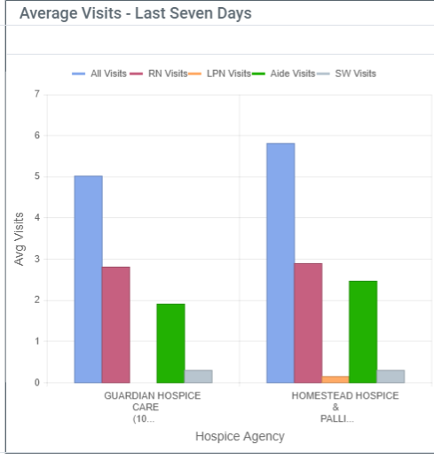
DR. MARK SMITH | TWIN OAKS HOSPICE
KEY METRIC: AVERAGE VISITS – LAST SEVEN DAYS
The last seven days of a patient's life is that period where the patient is actively dying, and the type and frequency of care should change to reflect the different patient and family requirements. Although there is no numeric standard, CMS considers that excellent service in this period would include an increase of total visits and a larger ratio of visits by RNs to keep pace with changes in care requirements.
Average visits – Last Seven Days - The last seven days of a patient's life is that period where the patient is actively dying, and the type and frequency of care should change to reflect the different patient and family requirements.

Slide 6
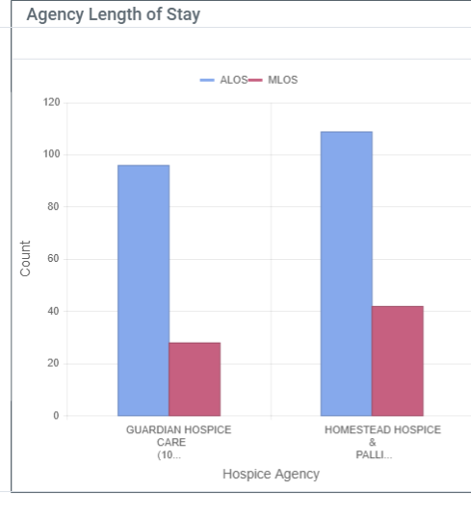
DR. MARK SMITH | TWIN OAKS HOSPICE
KEY METRIC: READMISSION RATE
We focus on providing early hospice care and longer ALOS to reduce end-of-life costs while also improving the patient and family experience. Partnering with the right hospices and referring appropriate patients sooner can makes a big impact on quality of life and overall costs.
Average Length of Stay – Average length of stay for all patients discharged from this hospice within the specified time period.

Slide 7
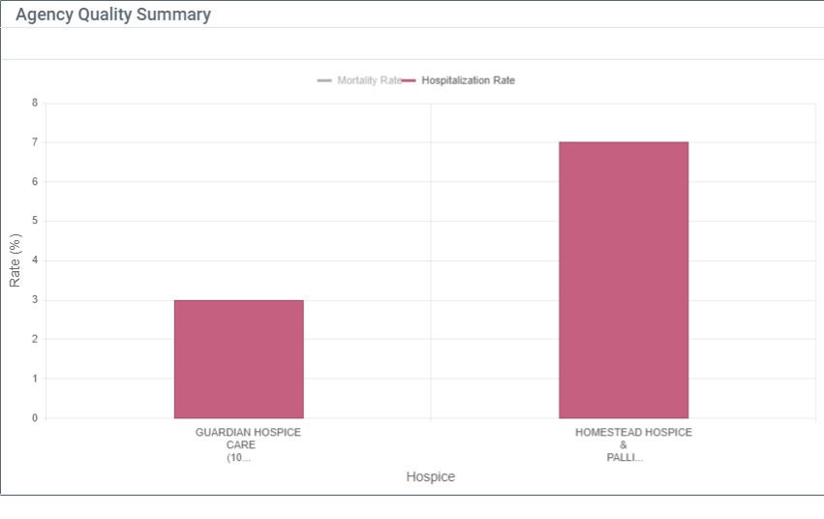
DR. MARK SMITH | TWIN OAKS HOSPICE
KEY METRIC: HOSPITALIZATION RATE
Our team of caregivers focus on providing the right care at the right time to our hospice patients. This helps reduce the need for acute services, as evidenced by our lower hospitalization rate.
Hospitalization Rate – The agency’s two year overall rate of hospitalization (where this agency’s patients were admitted to a short-term acute stay during a home health services episode (includes transfers) OR within 30 days of Home Health discharge).

Slide 8
SUMMARY
Curabitur sem ante, blandit eu vehicula nec, dictum non mauris. Nulla volutpat tincidunt enim ac faucibus. Nullam et vehicula neque. Nulla rutrum est nisi, in mollis tortor porttitor semper. Ut varius et magna ullamcorper ullamcorper. Vestibulum in tristique mi. Proin sed orci eu elit vehicula placerat .
Sed mollis pellentesque risus, eu scelerisque enim varius eget. Interdum et malesuada fames ac ante ipsum primis in faucibus.
Nunc justo odio, imperdiet nec varius et, efficitur a neque
Interdum et malesuada fames ac ante ipsum primis in faucibus.
Thank You
John Jones
jjones@twinoakshospice.com
322-123-4567

